Slide 1
City of Tracy
Parks Commission Meeting
Thursday, May 7th, 2026

Slide 2
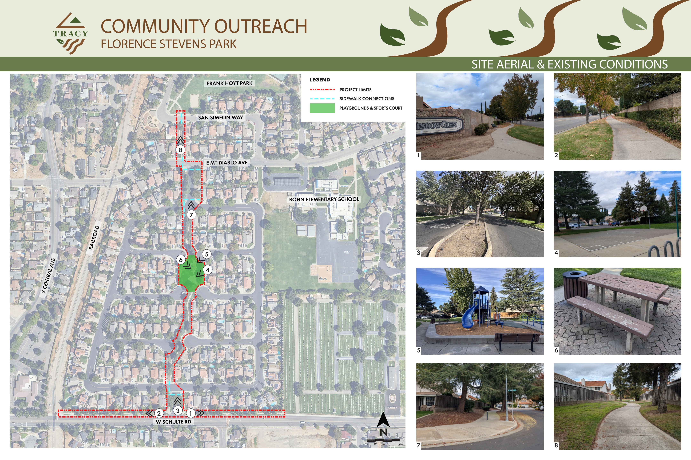

Existing Conditions

Slide 3
Existing Conditions

Slide 4
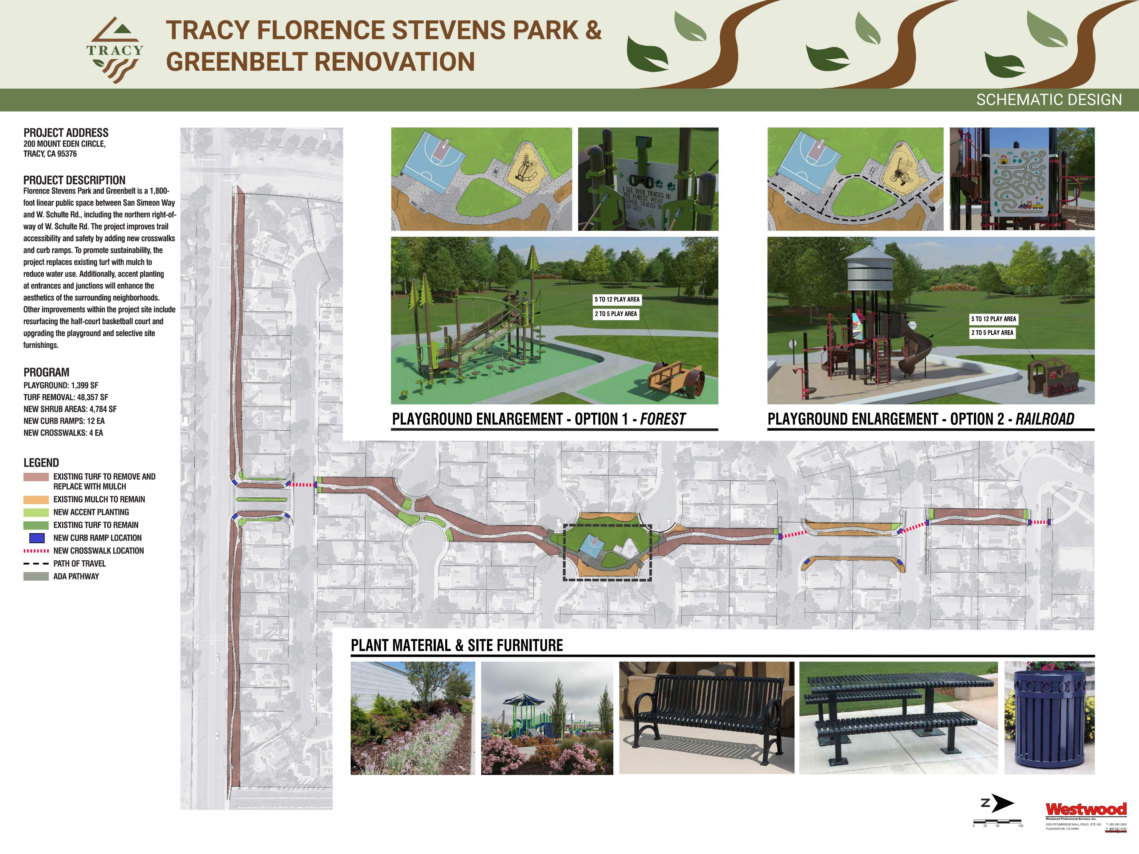
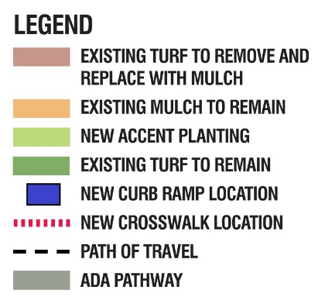
Proposed Improvements
West Schulte Road – Cedar Mountain Drive
CEDAR MOUNTAIN DRIVE
EXISTING VINES AND SHRUBS TO REMAIN
WEST SCHULTE ROAD
Note:
Upgrades to site lighting are not part of proposed scope.

Slide 5
Proposed Improvements
West Schulte Road – Cedar Mountain Drive
CEDAR MOUNTAIN DRIVE
EXISTING VINES AND SHRUBS TO REMAIN
WEST SCHULTE ROAD
Note:
Upgrades to site lighting are not part of proposed scope.

Slide 6
Proposed Improvements
West Schulte Road – Cedar Mountain Drive
LOMA PRIETA CIRCLE
WEST SCHULTE ROAD
EXISTING VINES AND SHRUBS TO REMAIN
CEDAR MOUNTAIN DRIVE
ARROYO HONDO CIRCLE
Note:
Upgrades to site lighting are not part of proposed scope.

Slide 7
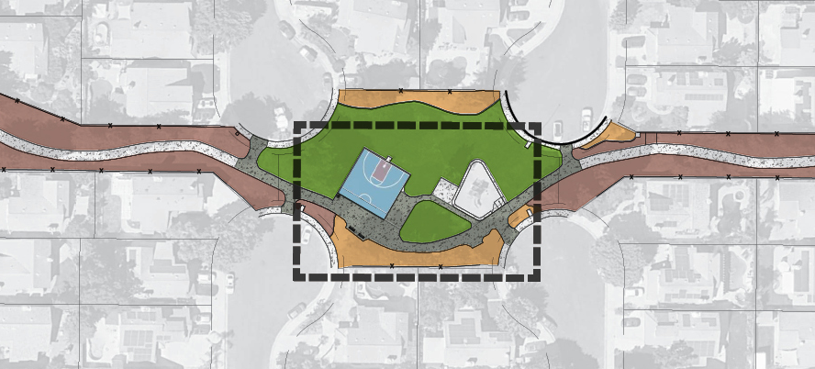
Proposed Improvements
Cedar Mountain Drive – Mount Hamilton Drive
ALUM ROCK COURT
MOUNT EDEN CIRCLE
EXISTING VINES AND SHRUBS TO REMAIN
TASSAJERA CIRCLE
ORESTIMBA CIRCLE
Note:
Upgrades to site lighting are not part of proposed scope.

Slide 8
Proposed Improvements
Mount Hamilton Drive – San Simeon Way
DALE ODELL DRIVE
EXISTING VINES AND SHRUBS TO REMAIN
SAN SIMEON WAY
EAST MOUNT DIABLO AVENUE
MOUNT HAMILTON DRIVE
Note:
Upgrades to site lighting are not part of proposed scope.

Slide 9
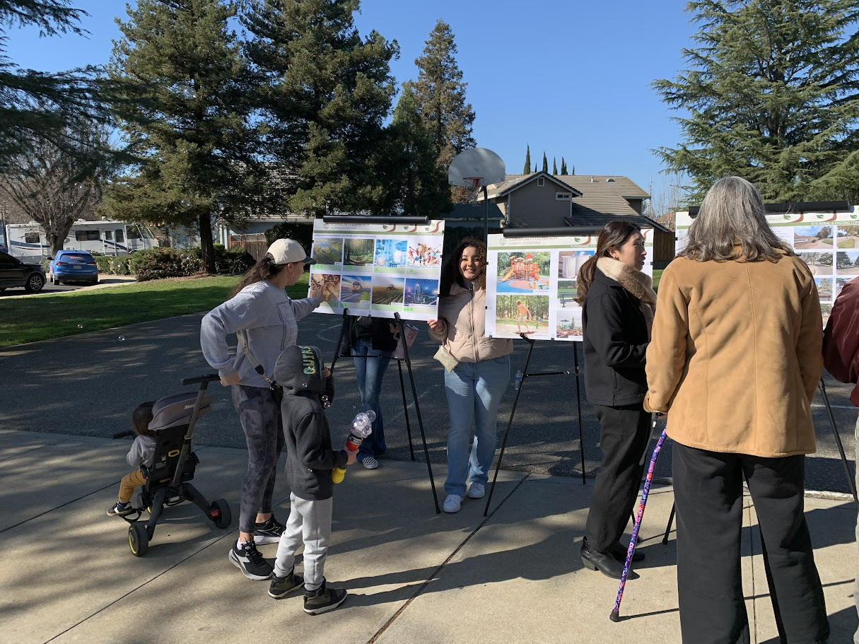
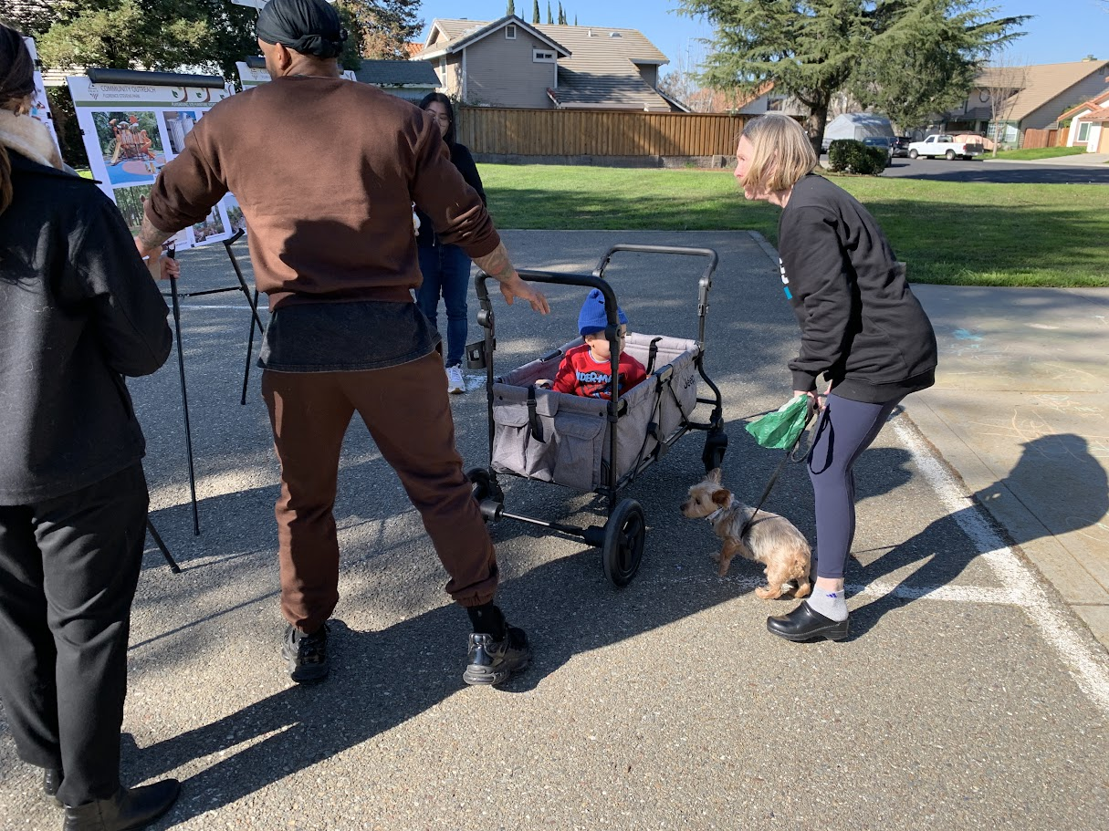
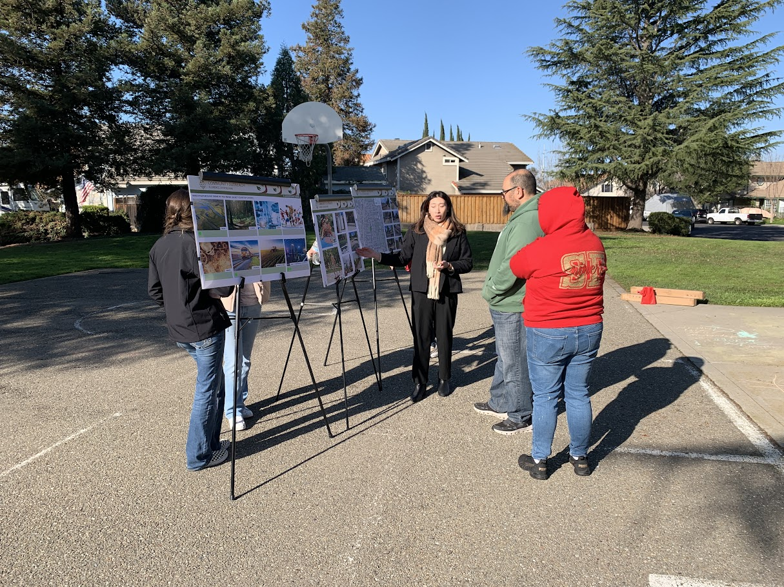
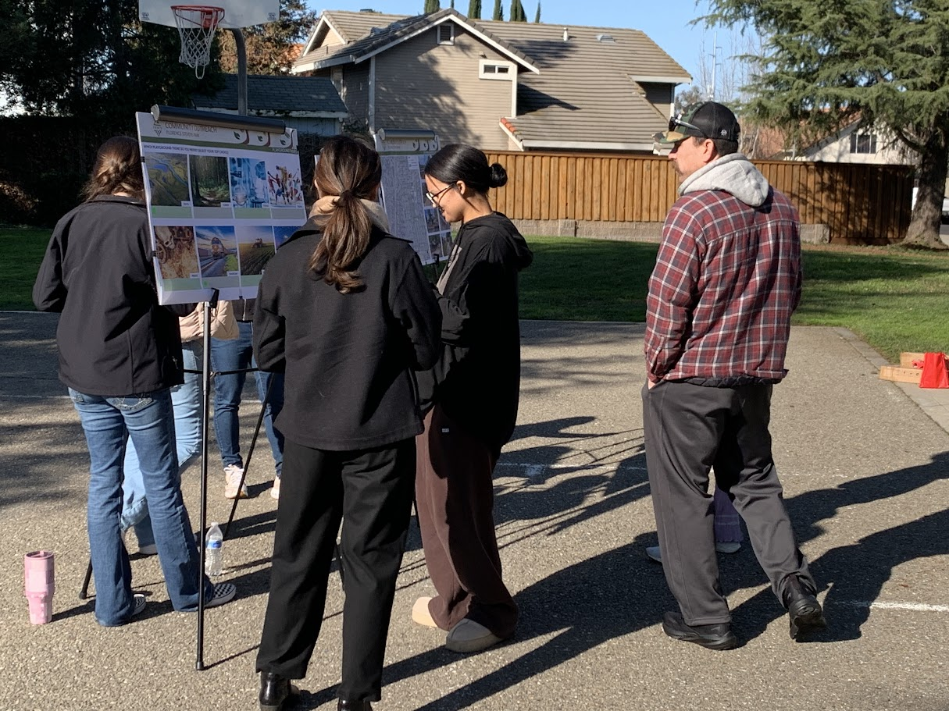
Community Outreach Meeting

Slide 10
Preferred Playground Themes
Result findings are combined from the online survey and public outreach meeting
Forest and Railroad are tied on the result

Slide 11
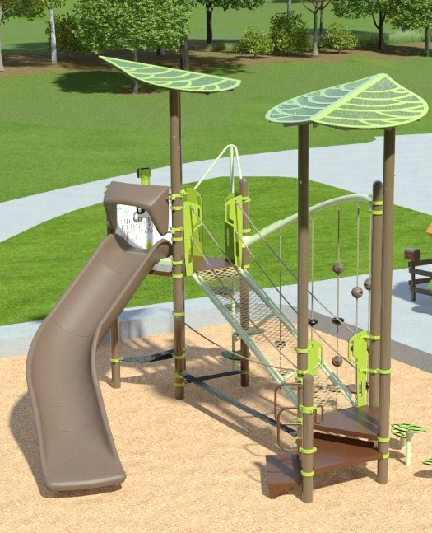
Playground Option 1
‘Forest’
The forest theme provides a nature-inspired play environment that complements Tracy’s agricultural and open-space heritage while creating an immersive setting for imaginative and exploratory play.

Slide 12
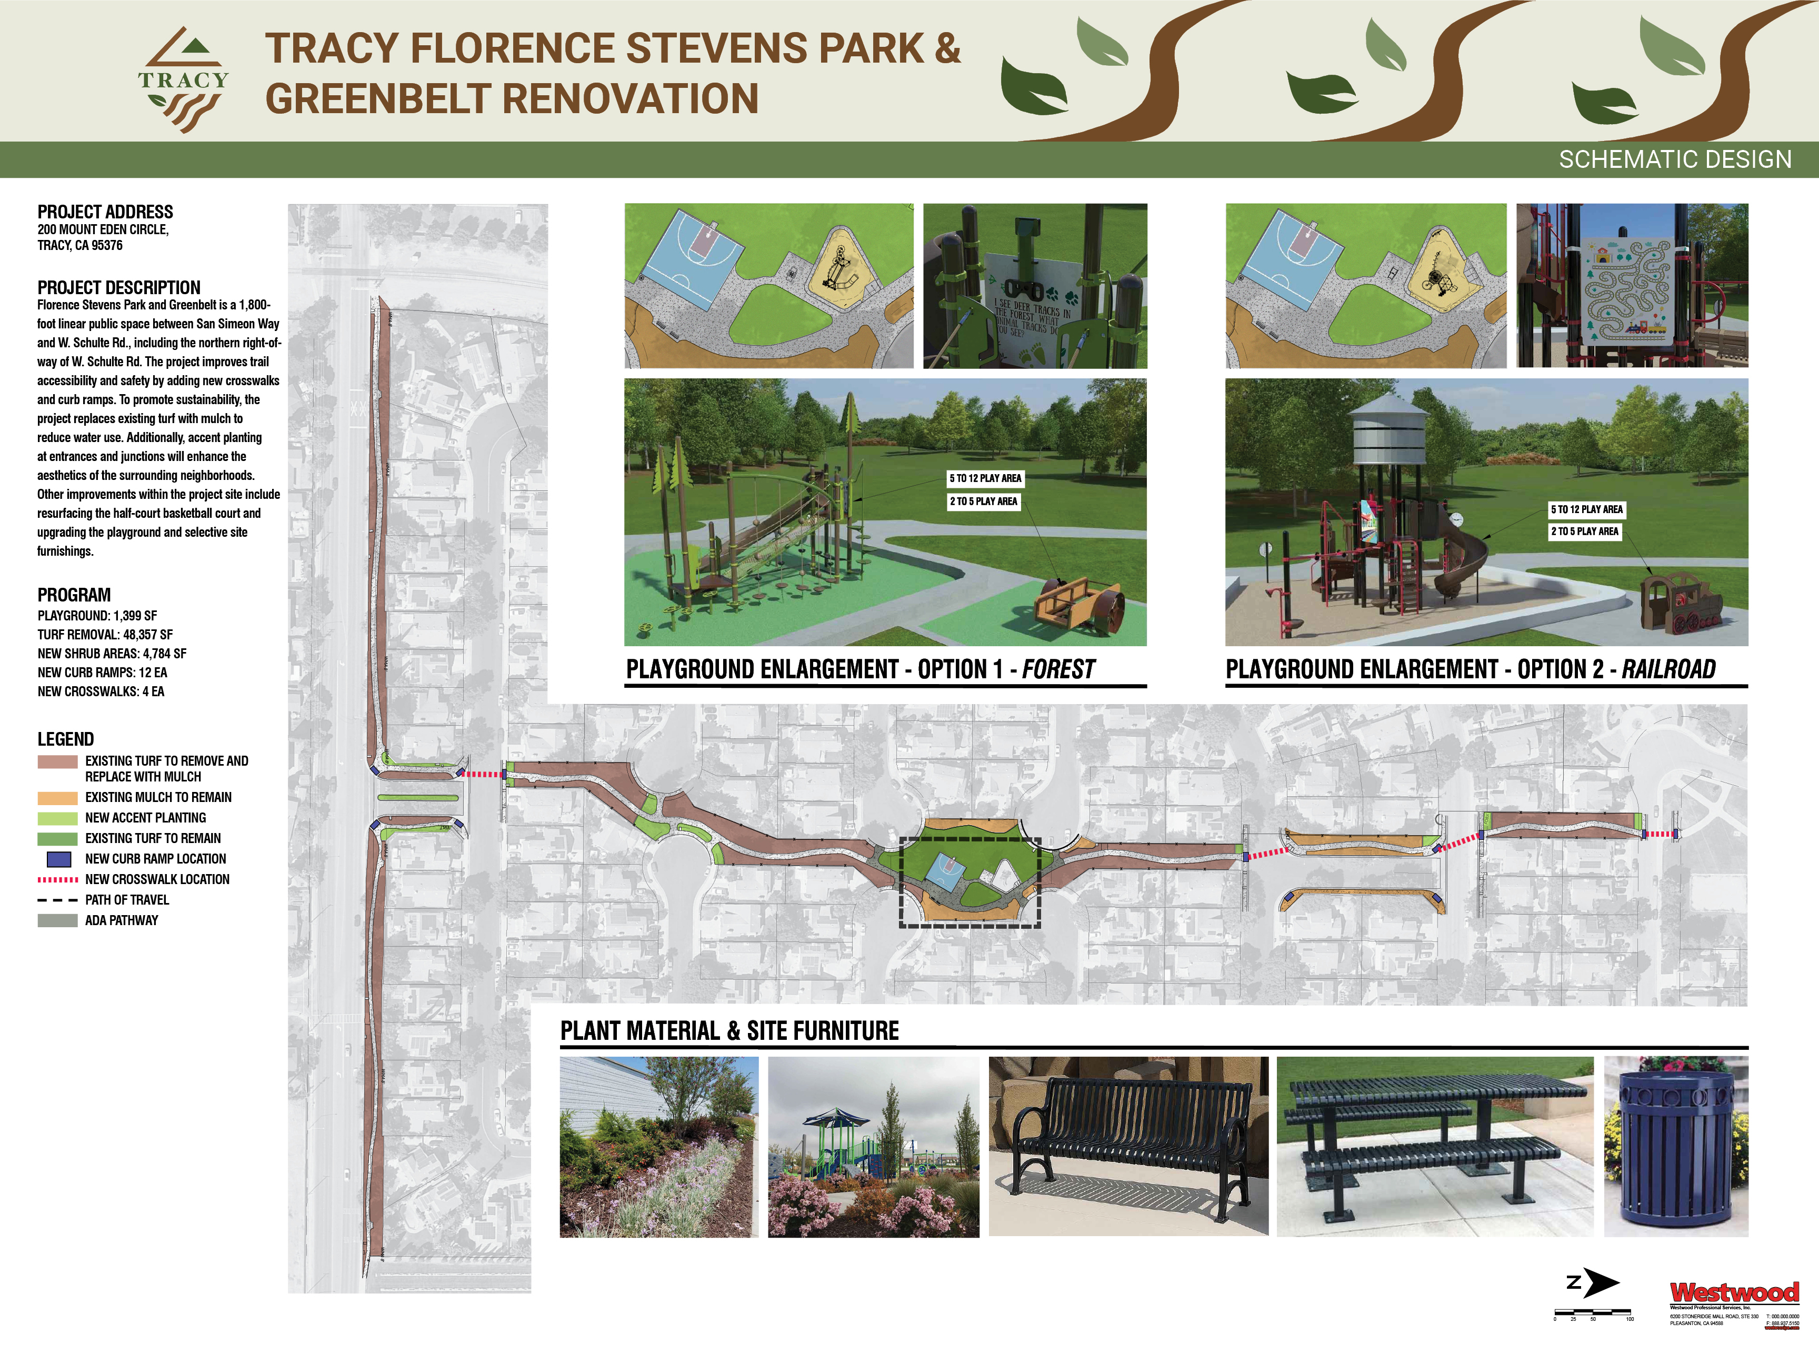
Playground Option 1
‘Forest’
Playground Entry
Renovated 5-12 Playground
Renovated 2-5 Play Area
Most favored by the community
Features various climbing elements with sliding opportunities
Includes under-structure play equipment to encourage exploration and imaginative play
Resurfaced Basketball Court

Slide 13
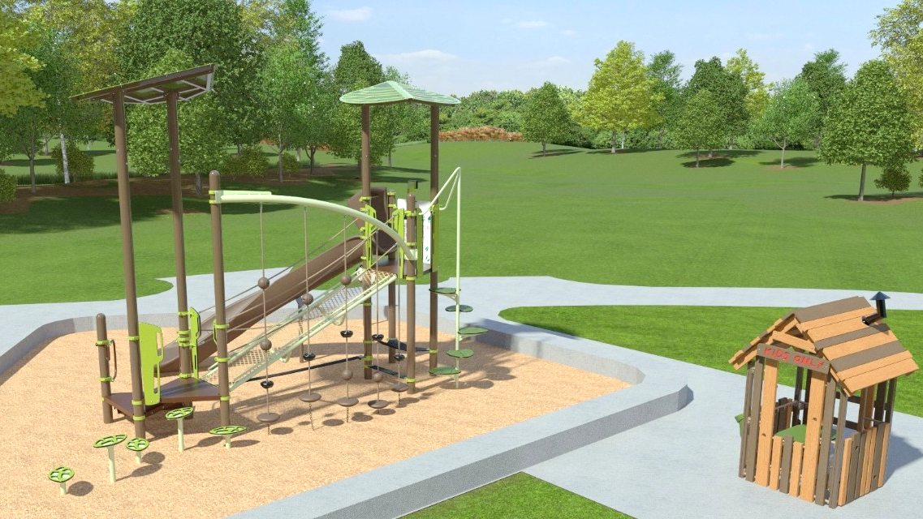

Slide 14
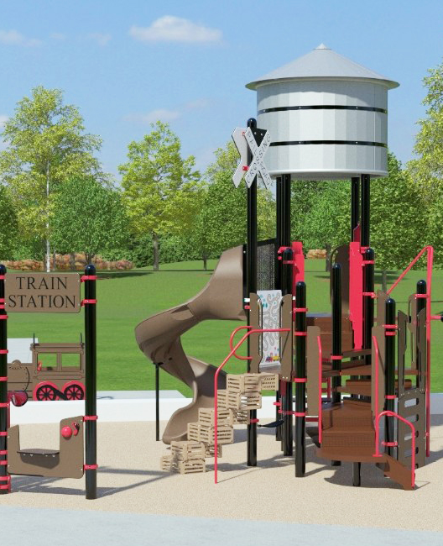
Playground Option 2
‘Railroad’
The Railroad theme celebrates Tracy’s proud railroad heritage and the role trains played in connecting the Tracy community to the wider region.

Slide 15
Playground Option 2
‘Railroad’
Playground Entry
Renovated 5-12 Playground
Renovated 2-5 Play Area
Celebrates Tracy’s proud railroad heritage
Integrates custom railroad-themed elements to boost imagination
Features a spiral slide and overhead climbing opportunities
Resurfaced Basketball Court

Slide 16
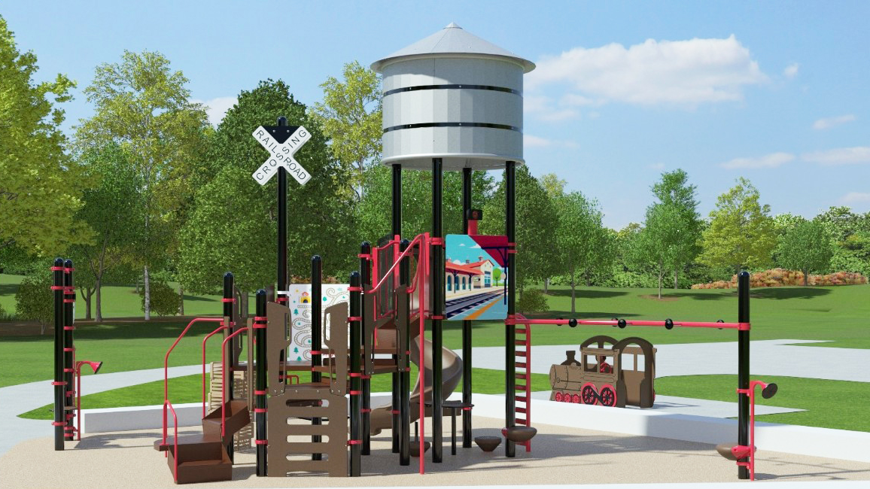

Slide 17
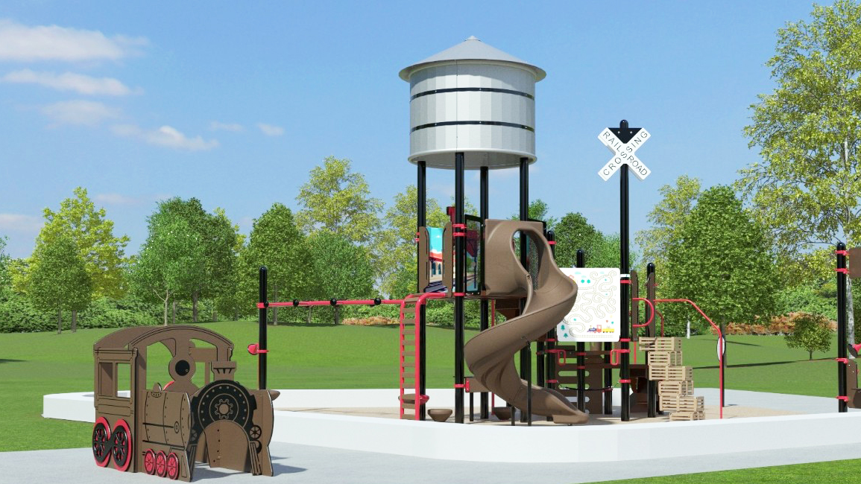

Slide 18
Next Steps
Budget Reconciliation / Value Engineering
Design Development
  Construction Documents
  Bidding and Award
  Construction

Slide 19
Thank you!

