Slide 1
HOMELESSNESS STRATEGIC PLANNING SESSION
City of tracy

Slide 2
OVERVIEW
Welcome and Introductions
Strategic Plan Overview
Summary of Process to Date
Interactive Presentation
Review of Goals
Next Steps

Slide 3
WELCOME AND INTRODUCTIONS

Slide 4
STRATEGIC PLAN OVERVIEW

Slide 5
SUMMARY OF PROCESS TO DATE

Slide 6
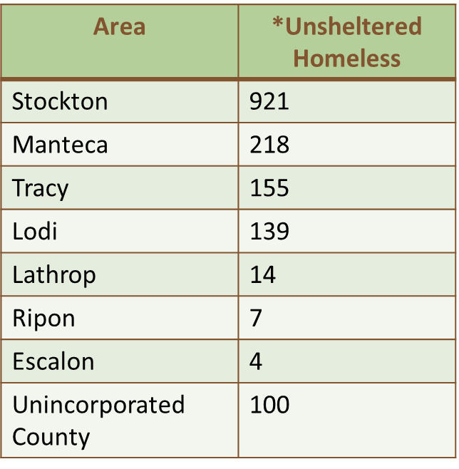
POINT IN TIME COUNT OF HOMELESS
JANUARY 2019
1,558 unsheltered homeless within the geographical area of San Joaquin County – up from 567 in 2017

Slide 7
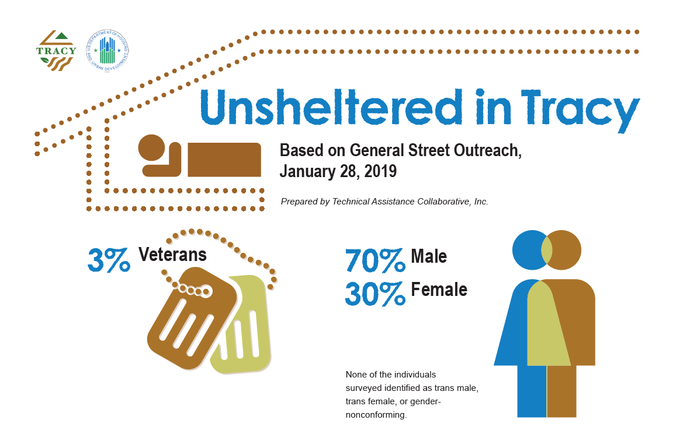
SAN JOAQUIN COUNTY

Slide 8
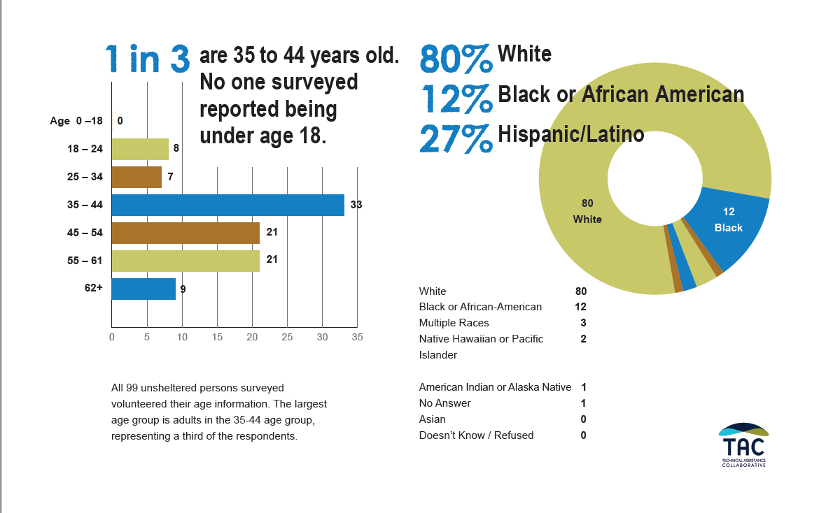
SAN JOAQUIN COUNTY

Slide 9
COUNCIL ACTIONS
April 16, 2019 – Council forms Ad Hoc Committee to develop a strategic plan to address homelessness in Tracy.
  Council Members Ransom and Arriola are appointed to the committee.
June 18, 2019 – Council authorizes staff to apply for technical assistance to develop a Homelessness Strategic Plan.

Slide 10
CITY ACTIVITY
Nov 2019
1st Strategic Planning Session for Service Providers and Strategic Partners facilitated by TAC
Dec 2019
Two Community Workshops held, and launch of City of Tracy Homelessness Resource Website
Jan 2020
Community Forum facilitated by TAC

Slide 11

TAKE OUR REAL-TIME SURVEY!
WWW.MENTI.COM
ENTER CODE
74 04 22

Slide 12
REVIEW OF DRAFT GOALS AND OBJECTIVES

Slide 13
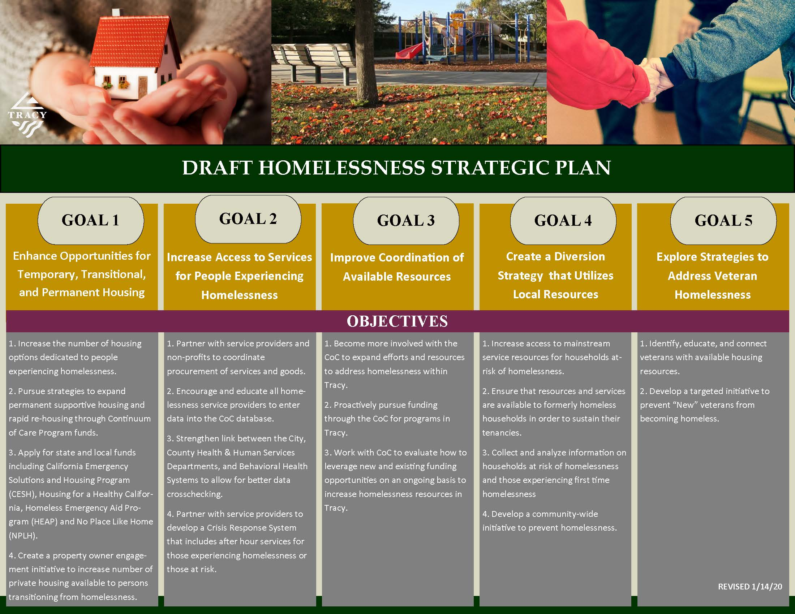

Slide 14
NEXT STEPS
Present Strategic Plan to City Council
  Coordinate with County and Continuum of Care to ensure continuity among strategic plans.
  Present comprehensive update to include a summary of public comments and details from previous meetings at January 21, 2020 Regular Council Meeting.
  Present draft strategic plan for Council consideration on March 17, 2020.
Continue exploring feasibility of establishing low-barrier temporary emergency shelters in Tracy.

Slide 15
Q & A

Slide 18
What is the City doing about
Homelessness in tracy?
In 2018, Code Enforcement investigated 94 homeless encampments
Public Works, PD and Code have coordinated efforts to proactively address issues related to homelessness (camping in parks, code violations, encampments, etc.)
Participation with “Operation Helping Hands” (OHH),
  This team includes the Tracy Police Neighborhood Resource Officers, San Joaquin County Homeless Behavioral Health Department, Care-Link and Central Valley Housing. Local non-profit and church organizations also accompany the team on the third Thursday of each month, performing site visits to the various locations where the unsheltered gather, to share information on available services and programs
Staff is working with other allied agencies and community partners to address homelessness in Tracy

Slide 19
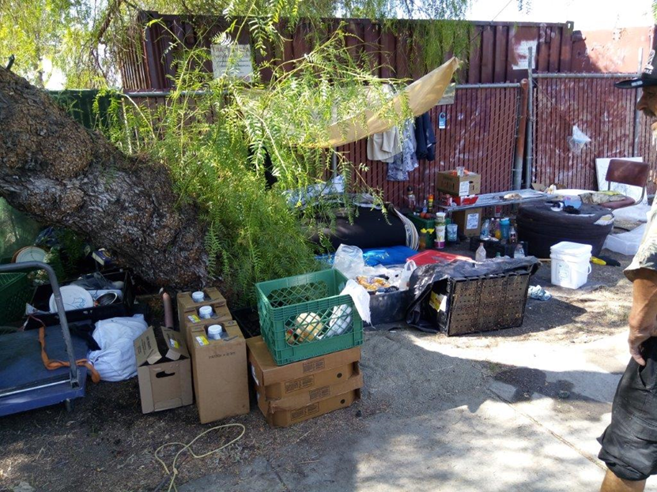
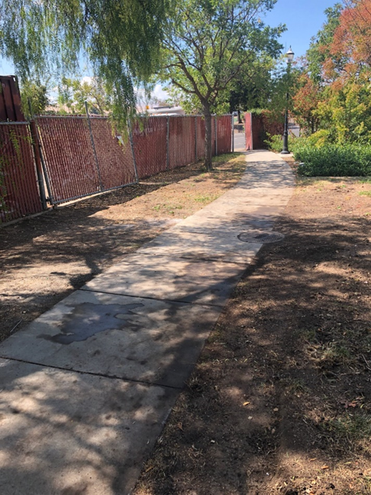
CLEAN UP EFFORTS:
PLASENCIA FIELDS
BEFORE
AFTER

